Slide 1

Friday
November 18,2016
Note – Project – The review packet should be completed and turned in on 11/28 (Your final project grade, essential to pass this class)
GPS -
SPS7. Students will relate transformations and flow of energy within a system.
a. Identify energy transformations within a system (e.g. lighting of a match).
b. Investigate molecular motion as it relates to thermal energy changes in terms of conduction, convection, and radiation.
c. Determine the heat capacity of a substance using mass, specific heat, and temperature.
Catalyst: Given, Un Known , equation &Solution must be shown.
What is the mass of an elevator that has 4000 J of energy and has a velocity of 32m/s?
Learning targets,
Our goal is 80%
I can Identify energy transformations within a system
I can differentiate between conduction, convection and radiation
I can calculate for potential and kinetic energy
I can differentiate the various forms of energy
I can relate energy and work
I can relate determine the heat capacity of a substance
I can explain the difference in mass and weight
And answer a question like this:
Topic: Energy transformations
Essential Question:
How is energy conserved?
Identify the different types of energy transformation in each cases
a)Windmill b) Flash light 3)microwave

Slide 2
Agenda -
Milestones Domain/Weight: Atomic and Nuclear Theory and the Periodic Table 25%
Catalyst | 10 min
Intro-reading a solubility chart | 30 min
Tasty solution - Lab | 30 min.
Video - conclusion | 10min

Slide 3
16.1 – Thermal Energy & Matter
“Everything around us is made up of energy. To attract positive things in your life, start by giving off positive energy.” - Unknown

Slide 4
Learning Targets Section 16.1
Explain how heat and work transfer energy
Relate thermal energy to the motion of particles that make up a material.
Relate temperature to thermal energy and to thermal expansion.
Calculate thermal energy, temperature change, or mass using the specific heat equation.
Describe how a calorimeter operates and calculate thermal energy changes or specific heat using calorimetry measurement.

Slide 5
In what direction does heat flow spontaneously?
What is heat?
Heat is the transfer of thermal energy from one object to another because of a temperature difference.
Heat flows spontaneously from hot objects to cold objects.

Slide 6
What is the temperature of an object related to?
Temperature is related to the average kinetic energy of the particles in an object due to their random motions through space.
Temperature is a measure of how hot or cold an object is compared to a reference point.
  On the Celsius scale, the reference points are the freezing and boiling points of water.
  On the Kelvin scale, absolute zero is defined as a temperature of 0 kelvins.

Slide 7
More on Temperature
As an object heats up, its particles move faster, on average. The average kinetic energy of the particles increases.
  One way that heat flows is by the transfer of energy in collisions.
  On average, high-energy particles lose energy. Low-energy particles gain energy.
  Overall, collisions transfer thermal energy from hot to cold objects.

Slide 8
What two variables are thermal energy related to?
Thermal energy is related to the total potential and kinetic energy of all the particles in an object.
Thermal energy also depends on the mass, temperature, and phase (solid, liquid, or gas) of an object.

Slide 9
More Thermal Energy
Thermal energy depends on mass. A cup of tea and a teapot full of tea can have the same temperature.
  The average kinetic energy of the particles is the same in the cup and the pot.
  There is more thermal energy in the teapot because it contains more particles.
.

Slide 10

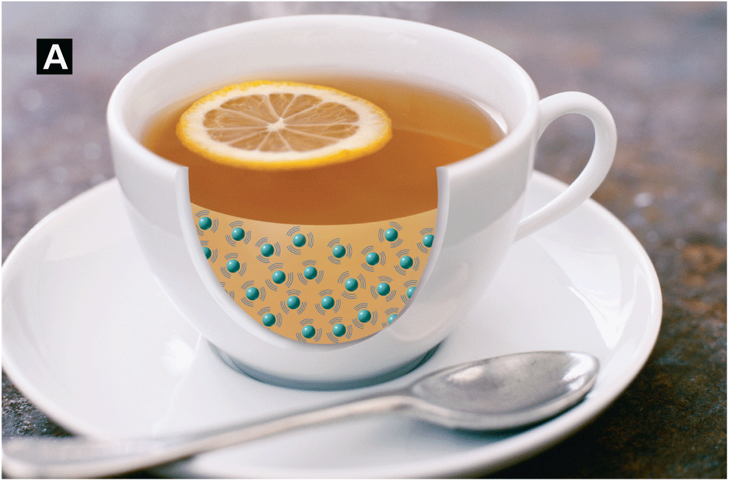
Thermal energy depends on mass and temperature
The tea is at a higher temperature than the lemonade.
The lemonade has more thermal energy because it has many more particles

Slide 11
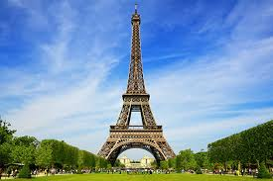
What causes Thermal expansion
Thermal expansion is an increase in the volume of a material due to a temperature increase.
Thermal expansion occurs when particles of matter move farther apart as temperature increases.

Slide 12
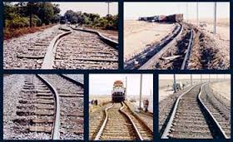

Slide 13
More Thermal Expansion
If you take a balloon outside on a cold winter day, it shrinks in a process of thermal contraction.
  As temperature decreases, the particles that make up the air inside the balloon move more slowly, on average.
  Slower particles collide less often and exert less force.
  Gas pressure decreases and the balloon contracts
If you bring the balloon inside, it expands.
Gases expand more than liquids and liquids usually expand more than solids.

Slide 14
Thermal Expansion and Thermometers
As temperature increases, the alcohol in a thermometer expands, and its height increases in proportion to the increase in temperature.
In an oven thermometer, strips of steel and brass expand at different rates as the coil heats up. The coil unwinds, moving the needle on the temperature scale.

Slide 15
What is specific heat?
Specific heat is the amount of heat needed to raise the temperature of one gram of a material by one degree Celsius.
The lower a material’s specific heat, the more its temperature rises when a given amount of energy is absorbed by a given mass.
.

Slide 16
EVERYDAY EXAMPLE OF SPECIFIC HEAT
.
When a car is heated by the sun, the temperature of the metal door increases more than the temperature of the plastic bumper.
The iron in the door has a lower specific heat than the plastic in the bumper.

Slide 17
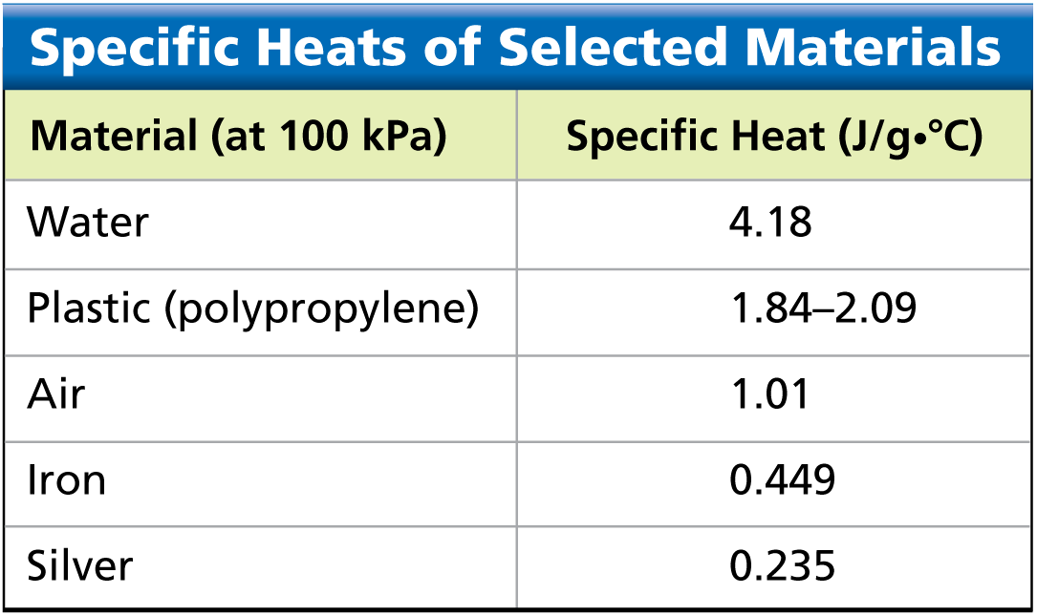
SPECIFIC HEAT

Slide 18

SPECIFIC HEAT FORMULA
In this formula, heat is in joules, mass is in grams, specific heat is in J/g•°C, and the temperature change is in degrees Celsius.

Slide 19
PRACTICE PROBLEM
An iron skillet has a mass of 500.0 grams. The specific heat of iron is 0.449 J/g•°C. How much heat must be absorbed to raise the skillet’s temperature by 95.0°C?

Slide 20
What is a calorimeter?
A calorimeter is an instrument used to measure changes in thermal energy.
The lower a material’s specific heat, the more its temperature rises when a given amount of energy is absorbed by a given mass.
According to the law of conservation of energy, the thermal energy released by a test sample is equal to the thermal energy absorbed by its surroundings.
The calorimeter is sealed to prevent thermal energy from escaping.

Slide 21
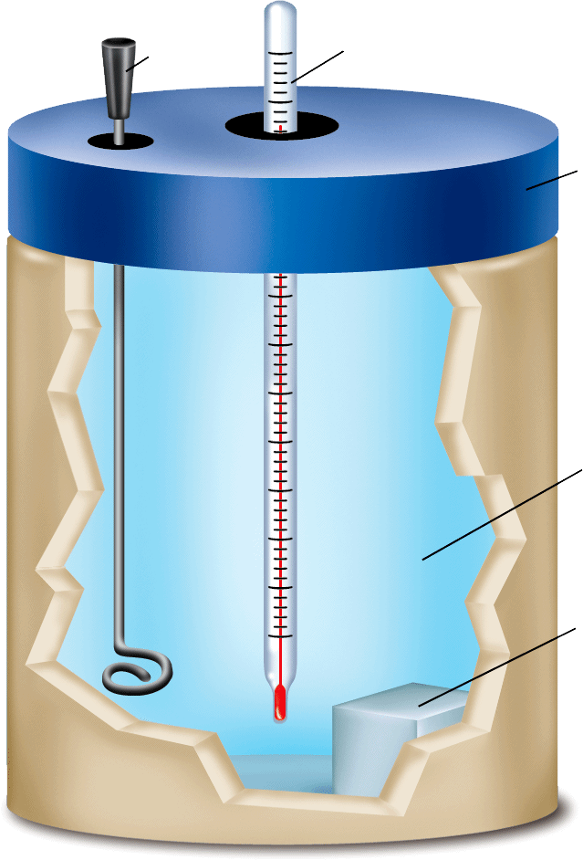
Calorimeter
A calorimeter is used to measure specific heat. A sample is heated and placed in the calorimeter. The temperature change is observed.

